Slide 1

What is Hybrid Cloud?
Sarah Lean
Senior Cloud Advocate
@Techielass

Slide 2
Momentum to a hybrid and multicloud strategy
90%
Momentum to hybrid
of enterprises depend on hybrid
Source: Gartner Says a Massive Shift to Hybrid Infrastructure Services Is Underway
Source: Cloud Computing Trends: 2020 State of the Cloud Report | Flexera Blog

Slide 3
Hybrid
Cloud

Slide 4
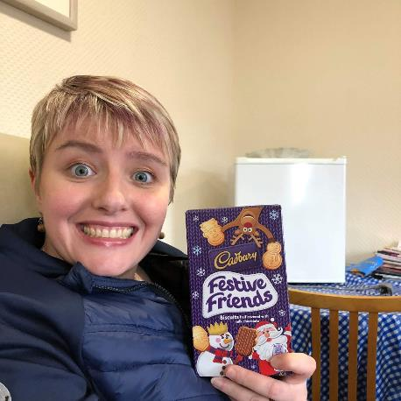

Who am I
Senior Cloud Advocate @ Microsoft
Blog at www.techielass.com
@Techielass
Founder of the Glasgow Azure User Group
STEM Ambassador
14+ years in the IT industry
IT Pro

Slide 5
“…Hybrid cloud computing refers to policy-based and coordinated service provisioning, use and management across a mixture of internal and external cloud services…” - Gartner

Slide 6

It’s a strategy

Slide 7
Why

Slide 8

On-Premises
Utilise investments
Utilise staff knowledge
Compliance

Slide 9

Public Cloud
Flexibility
Simplify costs
Innovation

Slide 10
How to approach hybrid cloud

Slide 11
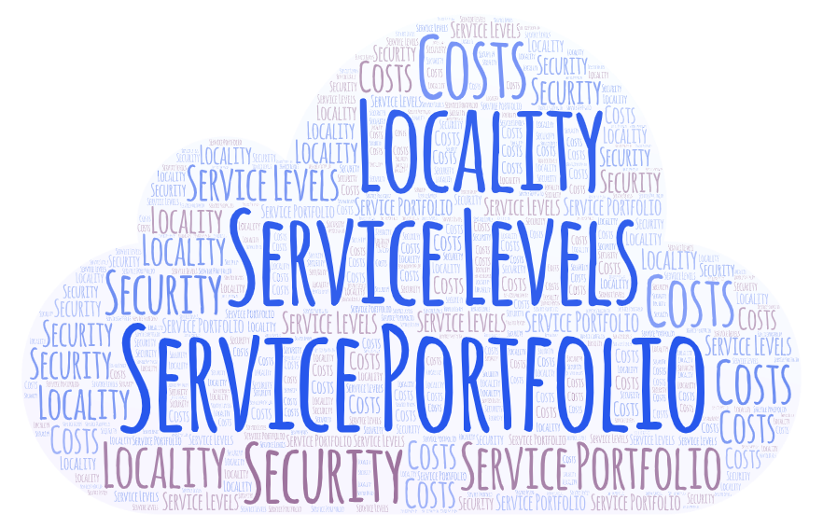
Choosing a cloud provider

Slide 12
Designing your environment
🏢 Where do you place each service?
✔️ Ensure you adhere to regulatory and compliance requirements
🔒 Ensure security standards are maintained
✍️ Day to day management
🔥 Operations
📚 Keep up to date

Slide 13
Talking points
🔐 Identity
🔗 Connectivity
✍️ Deployment methods
📜 Staff readiness

Slide 14
Manage hybrid cloud sprawl

Slide 15
Governance
🏢 Clear understanding of where services should reside
‼️ Duplication
💷 Cost Management
✍️ Periodical reviews

Slide 16






Guidance for a hybrid approach with Microsoft Azure
Plan
Govern
Manage
Define
Strategy
Adopt
Ready
Build skills across your team with Microsoft Learn
Accelerate deployment with Reference Architectures
Optimize workloads with Azure Well-Architected
Apply best practices to rapidly onboard
Review technical documentation on featured products
Cloud Adoption Framework
Guide your cloud journey across people, process and technology
https://aka.ms/adopthybrid

Slide 17
Hybrid in summary
Modernization
Flexibility
Not right for everyone
Management
Staff Readiness

Slide 18

Thank you!
https://aka.ms/cloudfirst-resources
Sarah Lean
Senior Cloud Advocate
@Techielass
www.techielass.com

